Slide 1
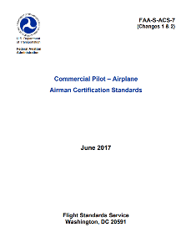
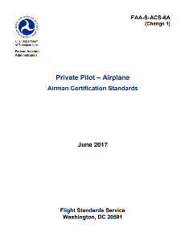
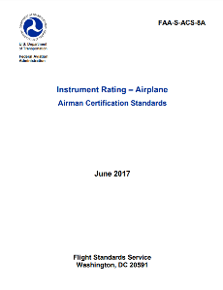
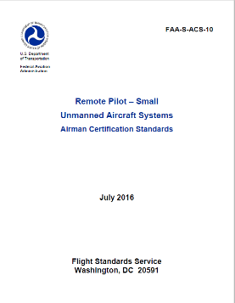
Using the Airman Certification Standards
General Audience
Federal Aviation Administration
Spring/Summer 2018
Notes:
Welcome! In the past two years, the FAA has been replacing the Practical Test Standards (PTS) with the Airman Certification Standard
s (ACS). The Private Pilot – Airplane (PAR) ACS and Instrument Rating – Airplane (IRA) ACS were released two years ago, and the Commercial Pilot – Airplane (CAX) ACS was released last year.
For 2018, the PAR, IRA and CAX have all undergone revisions. These revisions were driven by many factors, and we will discuss those change drivers, what was changed, and how those changes will affect you, the end user.
This presentation will cover the PAR, IRA, and CAX individually, many of the changes will be shown to you in this presentation.

Slide 2
Presenter/Panelists
Presenter
  Robert Terry, Airman Testing Branch
Panelists
  Margaret Morrison, Airman Testing Branch
  Ricky Krietemeyer, Airman Testing Branch
  Jeff Spangler, Airman Testing Branch
  Richard Orentzel, Airman Training and Certification Branch
  Jim Ciccone, Airman Training and Certification Branch
Notes:
Before we get started, there are some introductions I will like to make, and I will cover some Webinar operating procedures.
I am Robert Terry, I am assigned to the Airman Testing Branch, AFS-630, as an Operations Aviation Safety Inspector.
Our panelists today are: Margaret Morrison, Ricky Krietemeyer, and Jeff Spangler, from the Airman Testing Branch; and from the Airman Training and Certification Branch, AFS-810, we have Richard Orentzel and Jim Ciccone. All of our panelists are also Operations Inspectors.
During the Webinar, the panelists will answer your questions. They will do their best to give you an answer during the Webinar. For those questions that they are not able to answer due to time, or if the answer requires an interpretation of the rules, we will need to send you an answer in an email. All the questions and answers will be sent to all who have registered for the Webinar. I will also send this power point and my notes to everyone who registered for the Webinar. Please feel free to use this presentation if needed for any training or testing purposes.

Slide 3
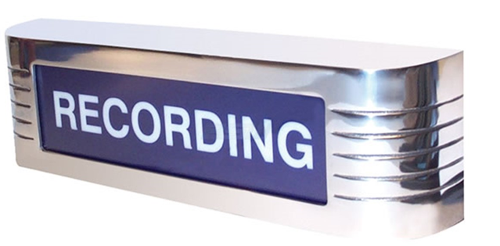
We are recording
We hope to make this webinar recording available for review.
Notes:
We are recording this Webinar, and plan to make it available on You Tube.

Slide 4
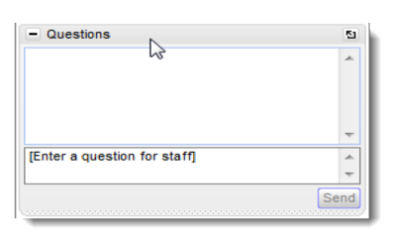
GotoWebinar Instructions
If you have questions, submit via the GotoWebinar panel
We will try to answer your questions during the Webinar, those that we miss will be answered in an email
Notes:
If you have a question or two during the Webinar, you may submit you question in the question box you see on your screen. Again, if we do not answer your question during the Webinar we will send all the questions and answers out in an email to all who have registered for the Webinar.

Slide 5

Control Panel Missing?
The control panel
minimizes
Click the red arrow
to bring it back
Notes:
If you are wondering, “where is my control panel?” it is minimized, to open it click the red arrow at the top of your screen to bring it up.

Slide 6
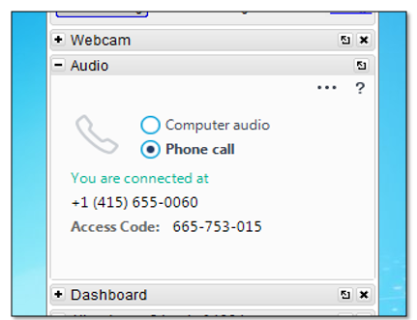
Audio Problem?
We recommend you call in.
Consider hanging up and calling in again.
Notes:
Are you having a difficult time hearing the Webinar? We have found, in the past, that using the speakers on a computer monitor do not work very well. We suggest that you use the call in number instead of your computer speakers. If there are audio or visual problems during the Webinar, please let us know through the question box, one of our panelists will let me know if there is an issue.

Slide 7


Overview – ACS Changes
What’s new in 2018?
  Private Pilot – Airplane – revised
  Instrument Rating – Airplane – revised
  Commercial Pilot – Airplane – revised
How do I use the ACS?
What’s next?
  ATP
  AMT
  Instructor
  Rotorcraft/Powered-Lift
Resources
Notes:
Here are the topics we’ll cover.
The focus of this Webinar is not to inform you about how the ACS works. The PAR and IRA ACSs have been active for two years, and the CAX has been in use for a year now. You, the end user, have a good working knowledge of the ACS. To use an analogy, you have seen the forest, it is time to look at the trees.
I will cover the PAR, IRA, and CAX individually and show you many of the changes that were made and the reason each change was made.
This project was a collaboration between the Airman Testing Branch and the GA Policy Branch. Our goal seemed easy enough when we started these revisions – just align the like Tasks and elements between the PAR, IRA, and CAX. For example, a V_{MC} demonstration for the PAR and CAX are the same except for the standards. This task turned out to be a little more daunting than expected. After significant work, phone calls, and revisions to our working spreadsheets, the project was completed.
We considered input from many sources, both those internal and external to the FAA. The question we continually asked our group was, “Is this usable for the end user? Will they understand what this is?”
Finally, there have been some changes to the standards in the ACSs. I will show you what those are also.

Slide 8

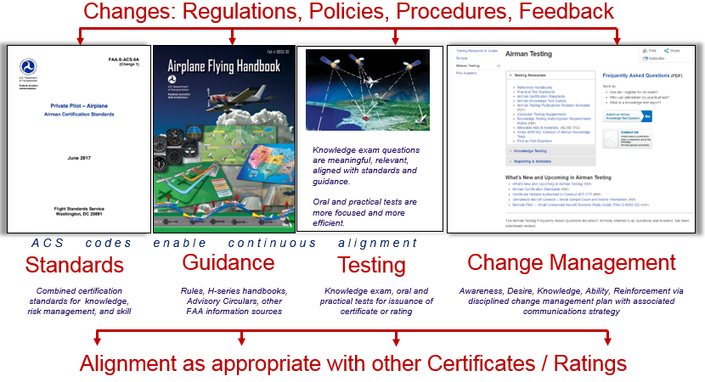
Airman Certification System
Notes:
The ACS is the Standard for airman certification, it is the “system” that the FAA, evaluators, instructors, and applicants will use in the certification process
As you can see, testing for the KT and the practical test begins with the ACS, the “standard”
The standard then drives guidance. In the case of the ACS, guidance is FAA handbooks, and other FAA publications.
The FAA guidance material is where all FAA KT questions are developed, as well as the questions for the practical test.
Change Management is how the FAA conveys updates to the user. This Webinar is an example of Change Management.
The visual that we used here is also an important part of Change Management. On the left side of the slide, is the Airman Testing Branch’s Web page. This is where all changes that are made in testing is posted. This is also the place, where you, the user of the ACSs can contact the Testing Branch. We encourage you to email us through our web page with your questions, comments, complaints, and yes even your accolades.
We, the Testing Branch, will answer your emails. Really we will. Over the past year we have kept and compiled all the comments we have received about the ACSs, and incorporated some of those comments into the changes that were made in this latest revision of the ACSs. Our internal work group reviewed EVERY comment from the past year.
The final slide in this presentation has our web address and the Airman Testing email address at the end, and I will email all the people who signed up for the Webinar a copy once we are done.

Slide 9
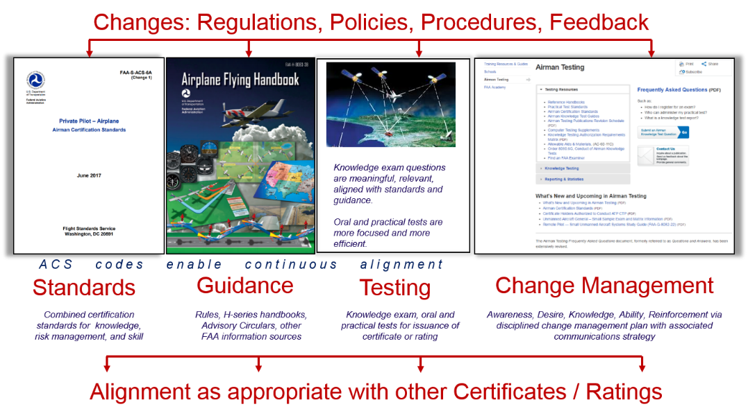
Airman Certification System
Statutes provide for the Administrator to determine qualifications and to use designees to examine/test/issue certificates.
49 USC 44703
49 USC 44702
The Administrator of the Federal Aviation Administration shall issue an airman certificate to an individual …qualified for…the position to be authorized by the certificate.
(d) Delegation The Administrator may delegate to a qualified private person …a matter related to—(A) the examination, testing, and inspection necessary to issue a certificate under this chapter; and (B) issuing the certificate
14 CFR part 61: FAA regulations set forth the requirements and conditions for issuance of pilot/instructor certificates & rating in terms of aeronautical experience and broad subject areas for aeronautical knowledge and flight proficiency (skill).
Implementing Guidance
Through the Aviation Rulemaking Advisory Committee (ARAC), the FAA receives essential advice and recommendations from the aviation community on keeping all components of the airman certification system up to date in the context of constant change.
Specific guidance to designees via the Practical Test Standards or Airman Certification Standards for a given certificate or rating.
Keeping FAA advisory handbooks up to date
Best practices for effective testing
Notes:
The ACSs are based on a Rule, 14 CFR part 61. What gives part 61 the authority to say how, why, and what an applicant must know, consider, and do to become a pilot? For that we need to look at Title 49 USC (United States Code) 44703 and 44702. These are Statutes, or Law. A Statute is “An act of legislature that declares, proscribes, or commands something; a specific law, expressed in writing.” This gives the Administrator the authority to use the ACS as the testing document that contains the standards for airman certification.
The ACS is supported by an Aviation Rulemaking Advisory Committee (ARAC). The ARAC provides rule making advice and recommendations to the Administrator with respect to pilot certification through the ACS System.

Slide 10
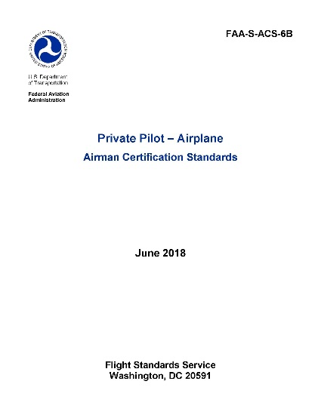
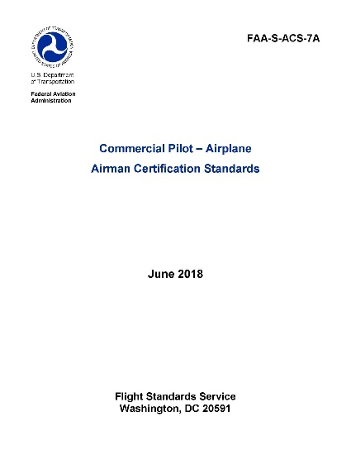

What Changed?
Private Pilot – Airplane, Instrument Rating – Airplane, and Commercial Pilot – Airplane ACSs
  Some changes are editorial
  Some changes clarify existing Task elements
  Updates made in the Appendices
  A few standards have changed
In the following slides we will cover these changes
Notes:
What changed?
As we progress through this presentation, you will see that the changes are editorial, meaning that a word was wrong or a comma was in the wrong place.
As I said earlier, one of our goals was to align like Tasks and elements amongst the three ACS documents. Of course, there are more like Tasks between the PAR and CAX. But, there are some that are common to all three. For example a single-engine approach in a multiengine airplane.
Other changes that you will see is that we have moved some Task elements around, we have even combined some elements to make them more clear, with the goal of making them easier to use. I will point out some of these as we go through this presentation.
Updates to the Appendices – The Appendices are an important part of each of the ACSs. There are test taking tips, testing qualifications (from the appropriate parts of 14 CFR part 61), English Language requirements, Safety of Flight, and a lot more information that is useful to an applicant, an instructor, and evaluators. We have made some changes here too. I will cover some of those.
A few standards have also changed. I will also hit some of these in this presentation.

Slide 11
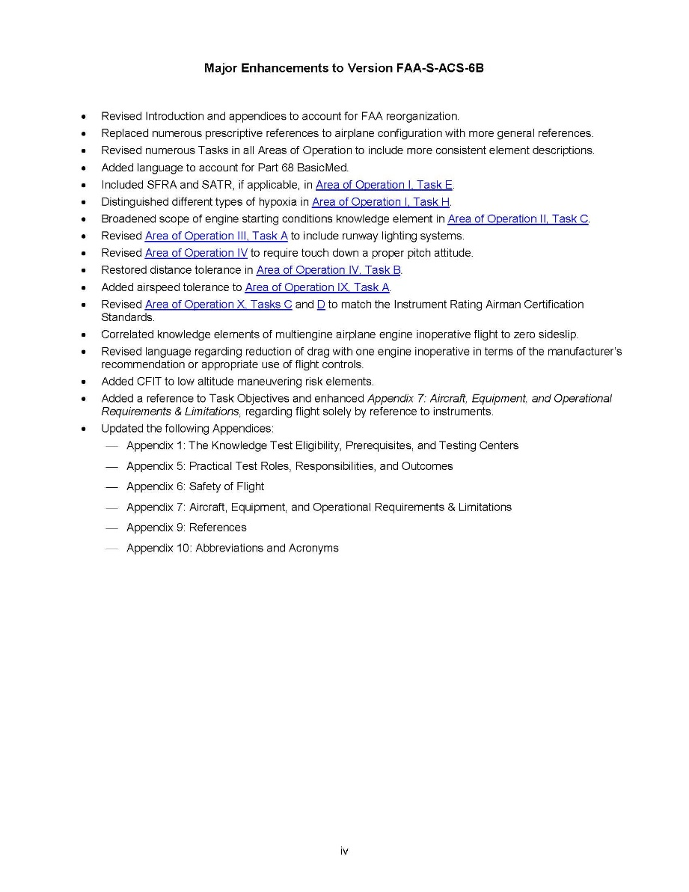
Major Enhancements Page
  Lists the following areas of the ACS:
  Introduction
  Tasks
  Individual elements
  Appendices
Notes:
As a user of the ACSs, the best place to start when looking for changes is the Major Enhancements page. This page will give you a pretty good look at what has changed, but, not always the place the change was made. For example, we replaced, “raise/lower the landing gear, raise/lower the flaps” with “Configure the airplane as per the manufacturer’s recommendations.” This is a change that was made in many places. And to list all of them was not practical.
So, please take some time to review the ACS or ACSs that you will use. This might sound strange to some people, but, read the document.

Slide 12
Introduction – Global
The Change: FAA reorganization
How that affects you:
  Some FAA “routing codes” have changed.
    For example, the Airman Certification Branch (the people who process applications for airman) has changed from AFS-760 to AFB-720
  We are no longer using routing codes to identify groups within the agency – we now use the group’s name.
Notes:
Within the past year, the FAA went through a reorganization. Gone are the days of Regions, such as the Southwest Region, the Southern Region etc. The individual Flight Standards District Offices are still in place, and the way you, the flying public, will more than likely still talk with the same FAA employees like you always have.
The change that will be most visible to you, will be that the routing codes for some of the Divisions/Branches that you might have contact with have changed. Such as the Airman Certification Branch. They are now identified as AFB-720, not AFS-760 like you are used to.
The other change you should see is that FAA employees are to refer to these Divisions/Branches by their official names. So, we will refer to the testing branch as “The Airman Testing Branch”, not AFS-630. Through this presentation, I will try to use both names, as all of us become accustomed to this change. This is a global change you will see in all of the ACSs.

Slide 13
Global Changes
Airplane Configuration
  Where it is appropriate, the use of “raise the landing gear” and “raise/lower the flaps” has been deleted
  You will now see language like this, “Configure the airplane as per the manufacturer’s recommendations.”
Task Elements
  The Tasks elements that are the same in the three ACSs, are now aligned.
Notes:
As I think everyone has seen by now, the requirement to use a complex airplane for the SE commercial and SE CFI practical test has been eliminated. The work group did anticipate that this change might happen after these ACSs were activated. To prepare for this change, we decided to use, “Configure the airplane as per the manufacturer’s recommendations.” For example, if an airplane that is fixed gear, but, has a constant speed propeller is used for a practical test, the applicant is to be tested as per the manufacturer’s recommendations. This is to be a catch-all for any airplane that meets the requirements of 61.45 for a practical test.
Tasks/Elements: There are only a few Tasks and Elements that are used in all three of the ACSs. You will see many more like Tasks/Elements between the PAR and CAX. Our goal was to make these Tasks/Elements the same. One that is the same across all three is adding an ME with an instrument rating. All three must do an instrument approach. You will see that these are the same. For the PAR and CAX, you should see that all like Tasks/Elements are the same, except for the standards for the maneuver between the certification categories.

Slide 14
Global Changes
BasicMed
  Is now a Knowledge testing and Practical testing element
Special Air Traffic Rules (SATR) and Special Flight Rules Area (SFRA)
  These are new testing elements, where they apply
New Task Name
  For Airport and Seaplane Base Operations Area of Operation, the name of Task A has been changed to include Runway Lighting Systems
Notes:
BasicMed has been allowed for about a year now. It has now been placed in the ACSs. It is now a testing element for both the KT and the practical test.
Special Air Traffic Rules (SATR) and Special Flight Rules Area (SFRA) are now testing elements also. You will see that we included “if applicable” in the Element. If a person is taking a practical test where SATR or SFRA does not apply to their area, this item is not to be tested.
We included Runway Lighting Systems to the Communications and Lights Signals Task. We realized as we were revising the ACSs that we did not have runway light systems as a testing item. This now allows Runway Light Systems to be tested.

Slide 15
Private Pilot – Airplane ACS
Task Element Changes
Normal Approach and Landing Task:
2017:
2018:
Area of Operation IX, Emergency Operations; Task A, Emergency Descent
2017:
2018:
Notes:
Here you see the Normal Approach and Landing Task with the Skill 10 and the changes that were made in the PAR ACS. The top example, from 2017 did not include the standard of landing within 400 feet or on a specified point. It is now included in the 2018 PAR ACS. This was an item that we received many comments about. We agreed and it has been added back into the standard. The proper pitch attitude at touchdown is now also included . The other change you see here is that we removed the ASEL, AMEL, ASES, and AMES. This Task applies to all classes in the airplane category. So, the airplane’s longitudinal axis will be aligned with and over the runway (land planes) or the landing path (seaplanes).
AOO IX, Task A, Emergency Descent and Landing, added airspeed and altitude standards. This is another one of our finds as we reviewed the PAR ACS. The CAX had an airspeed and altitude standard, the PAR did not. So, this standard was added to the PAR ACS.

Slide 16
Private Pilot – Airplane ACS
Task Element Changes
Area of Operation X, Multiengine Operations; Task C, One Engine Inoperative (Simulated)(solely by Reference to Instruments) During Straight-and-Level Flight and Turns (AMEL, AMES)
  This Task has been changed to match the Instrument and Commercial ACSs
  “Simulated” has been added to the Task name
  “Solely” has been added to the Task name
  Skill 2, the evaluator establishing zero thrust has been added
  Skill 4, bank angle has been replaced with “Use flight controls…”
Notes:
You will see that the ME Tasks and Elements have the most changes. As we were reviewing and comparing the PAR/IRA/CAX ACSs we saw that these maneuvers were very different. So, we made them the same. You see that we added “Simulated” in the Task name, this is to show that the engine failure is to be simulated. To reinforce this we also added that the evaluator is to establish zero thrust on the inoperative engine in Skill 2. Also in the Task name we added “solely” to Reference by Instruments” this aligns this maneuver as it is described in Part 61. You will also see in Skill 4, we deleted “bank angle” and replaced it with “Use flight controls in the proper combination as recommended by the manufacturer.” This allows the applicant to follow the proper procedure for an engine failure as it is outlined in the POH/AFM.

Slide 17
Private Pilot – Airplane ACS
Task Element Changes
Area of Operation X, Multiengine Operations; Task D, Instrument Approach and Landing with an Inoperative Engine (Simulated)(solely by Reference to Instruments)(AMEL, AMES)
  The same changes that were made to Task C were applied to Task D.
  2017:
  2018:
  2017:
  2018:
Task | D. Instrument Approach and Landing with an Inoperative Engine (Simulated) (by Reference to Instruments) (AMEL, AMES)
Task | D. Instrument Approach and Landing with an Inoperative Engine (Simulated) (solely by Reference to Instruments) (AMEL, AMES)
PA.X.D.S11 | Complete landing and the appropriate manufacturer’s checklist.
PA.X.D.S11 | Execute a normal landing.
PA.X.D.S12 | Complete the appropriate checklist.
Notes:
The changes that were made to AOO X, Task C, “Multiengine Operations” on the previous slide above were also applied to Task D on this slide. For reference I put the 2017 Task name here, to compare it to the 2018 Task name.
One other small change on this page, is that the landing and Completing the checklist are now two separate Elements. Since these are two separate steps, they needed to have two sparate elements.
While I have pointed out these changes, you are encouraged to look at these Tasks, and all of them to become familiar with the changes.
The standards have not changed in these Tasks. However, you will see new language that is used. The reason for this change is to not box an applicant, their instructor, or the evaluator into an element that cannot be done, or is unsafe for them to do in the airplane that is being used for the practical test.

Slide 18
Private Pilot – Airplane Appendices
Appendix 1: The Knowledge Test Eligibility, Prerequisites, and Testing Centers
  The English Language Standard has been updated
Appendix 3: Airman Knowledge Test Report
  Page A-6 now includes information about the importance of the applicant using their correct name(s) for the Airman Knowledge Test Report (AKTR)
Appendix 5: Practical Test Roles, Responsibilities, and Outcomes
  Changes have been made to Unsatisfactory Performance
  Removal of “Limited to Center Thrust” has been updated
Notes:
Please review the English Standard that is in Appendix 1, There have been some updates.
A new part of Appendix 3 has been added about the Airman Knowledge Test Report. The importance of an applicant using their correct name, in the same way (spelling, and order) throughout the certification process is very important. When an applicant uses a different spelling, or order of their name(s) for the KT and then for the PT in IACARA (or with a paper 8710-1 application), this can and will delay the processing of their application at Airman Records.
Appendix 5, “Practical Test Roles, Responsibilities, and Outcomes” has additional information. For an Unsatisfactory performance, there have been some changes here also. We have heard for years the complaint, “why does the applicant fail the entire AOO, if they only failed one Task.” Well, the answer is found in the rule. Due to this being anchored in part 61, we cannot make that change here. We must follow what the rule allows, or does not allow. However, we did attempt to make the process easier to follow.
In the current ACSs for PAR and CAX we left out an important sentence from the PTS. We have put the requirement for a person who wants to add an instrument rating when they remove a Center Thrust Limitation that they must also complete the requirements for removing the “Airplane Multiengine VFR Only” limitation.

Slide 19
Private Pilot – Airplane Appendices
Appendix 6: Safety of Flight-Multiengine Considerations
Appendix 7: Aircraft, Equipment, and Operational Requirements & Limitations.
Appendix 9: References
Appendix 10: Abbreviations and Acronyms
Notes:
Appendix 6:Safety of Flight, Multiengine Considerations. We have removed the requirement for an ME airplane to be used that was not certified with inflight unfeathering capability.
We also removed the language about the a type rating.
Appendix 7 says that the airplane used for the practical test must meet the requirements in 61.45. This change was made to remain consistent with the CAX ACS and the removal of the complex airplane for the practical test.
Appendices 9 and 10 have been updated to show changes to the references used and the appropriate abbreviations and acronyms.

Slide 20
Instrument Rating – Airplane ACS
The FAA reorganization information is the same as the Private and Commercial ACS
BasicMed, Part 68 information, is the same as the Private and Commercial ACS
Instrument Rating-specific changes will be covered in the next slides
Notes:
Next up is the IRA ACS.
If you compare the PAR/IRA/CAX ACSs, you will see that there are common changes that have been made. For example, the FAA reorganization and BasicMed. Since those were covered in the PAR information I will not cover those again.
There are changes that are specific to the IRA ACS. Those will be covered in the next slides.

Slide 21
Instrument Rating – Airplane ACS
The Objectives of many Tasks now have the added language, “solely by reference to instruments.”
  For example, Area of Operation III, Air Traffic Control Clearances and Procedures; Task A, Compliance with Air Traffic Control Clearances
  2017:
2018:
  In addition to the added language in the Task Objective, please refer to Appendix 7: Aircraft, Equipment, and Operational Requirements & Limitations (page A-15)
  Please note that this change has been made to numerous Tasks
Objective | To determine the applicant exhibits satisfactory knowledge, risk management, and skills associated with ATC clearances and procedures.
Objective | To determine the applicant exhibits satisfactory knowledge, risk management, and skills associated with ATC clearances and procedures solely by reference to instruments. Note: See Appendix 7: Aircraft, Equipment, and Operational Requirements & Limitations for related considerations.
Notes:
This is what appears to be a small change in this Task Objective for AOO III, Task A. However, it could have a significant impact. By not having “solely by reference to instruments” in the Objective Line, it allowed this Task to be completed without a view limiting device. Now this Task is required to be completed while the applicant uses a view limiting device.
For more information about using a view limiting device, please also refer to Appendix 7, page A-15.
While AOO III, Task A is used an example, this change has been made to numerous Tasks.

Slide 22
Instrument Rating – Airplane ACS
Area of Operation VI, Instrument Approach Procedures; Task A, Nonprecision Approach
  2017:
2018:
  The three elements shown from the 2017 version are now combined into one element
  Addition of AC 120-108 in the Reference Line
  Now allows a Continuous Descent Final Approach (CDFA)
IR.VI.A.S10 | Establish a stabilized approach with a rate of descent and track that will ensure arrival at the MDA prior to reaching the missed approach point (MAP).
IR.VI.A.S11 | Maintain no more than a ¾-scale deflection of the CDI, and maintain airspeed within ±10 knots of desired value while on the final approach segment.
IR.VI.A.S12 | Maintain the MDA, when reached, within +100 feet, −0 feet to the MAP.
IR.VI.A.S11 | For the final approach segment, maintain no more than a ¾-scale deflection of the CDI, maintain airspeed ±10 knots, and altitude, if applicable, above MDA, +100/-0 feet, to the Visual Descent Point (VDP) or Missed Approach Point (MAP).
Notes:
As you can see in AOO VI, Task A, nonprecision approach there has been a noticeable change. We have combined 3 elements into 1. In addition, please look at the Reference Line for this Task. You will now see the addition of AC 120-108, “Continuous Descent Final Approach.”
In the 2017 ACS, the applicant was forced to maintain the MDA +100/-0 feet until they reached the MAP. With this change, it allows the applicant to fly a more stabilized approach from the Final Approach fix without having to do a level off at the MDA until the MAP is reached. Please refer to AC 120-108 for additional guidance.

Slide 23
Instrument Rating – Airplane ACS Appendices
The changes that were made in the Private and Commercial Pilot ACSs, will also be found in the Instrument Rating – Airplane ACS.
There is one change in Appendix 7, second paragraph under “Aircraft Requirements & Limitations”.
  Applicants testing in a multiengine airplane must provide a multiengine airplane with a published V_{MC}. The only exception is if the airman’s certificate is limited to center thrust.
Notes:
Most of the changes that we have already covered in the Private ACS Appendices also apply to the Instrument ACS Appendices, with one exception.
In Appendix 7, that is titled, “Aircraft, Equipment, and Operational Requirements & Limitations”
Under the paragraph: “Aircraft Requirements & Limitations”
This is the new language: “Applicants testing in a multiengine airplane must provide a multiengine airplane with a published V_{MC}. The only exception is if the airman’s certificate is limited to center thrust.”
While this new language may seem like a person cannot accomplish their instrument practical test in an airplane that is limited to center thrust, they may use a center thrust airplane, provided their pilot certificate has the center thrust limitation already on it.
So, the new language does not permit an applicant to use an airplane that is limited center thrust who does not have a center thrust limitation on their pilot certificate.

Slide 24
Commercial Pilot – Airplane ACS
Most of the changes made to the Private Pilot and Instrument Rating ACSs were also applied to the Commercial Pilot ACS; however, there are a few changes that are specific to the Commercial Pilot ACS.
Changes to the Task elements
  Added the evaluator’s discretion for full stalls
  Configure the airplane as per the manufacturer’s recommendations
Changes to the Appendices
  Appendix 5
  Appendix 7
Notes:
Most of the changes that we have already covered in the Private and the instrument ACSs will also be found in the Commercial ACS.
I do mention “configure the airplane as per the manufacturer’s recommendation” here. As I am sure most, if not all of you, know that the requirement for a complex SE airplane is no longer required for the commercial practical test. Since this has already been shown in the Private ACS, I will not cover those specific Tasks/Elements in the CAX.
However, I will cover some of the other changes that are specific to the CAX.
We will first look at the changes in the Tasks/Elements
Then we will cover the changes in the appendencies

Slide 25
Commercial Pilot – Airplane ACS
Area of Operation VII; Task B, Power-Off Stalls; and Task C, Power-On Stalls
  2017:
2018:
  2017:
2018:
CA.VII.B.S7 | Acknowledge the cues and recover promptly at the first indication of an impending stall (e.g., aircraft buffet, stall horn, etc.).
CA.VII.B.S6 | Maintain a specified heading, ±10 if in straight flight; maintain a specified angle of bank not to exceed 20°, ±5°, if in turning flight, until an impending stall is reached.
CA.VII.C.S7 | Acknowledge the cues and promptly recover at the first indication of an impending stall (e.g., aircraft buffet, stall horn, etc.).
CA.VII.C.S6 | Maintain a specified heading ±10° if in straight flight; maintain a specified angle of bank not to exceed 20°, ±10°, if in turning flight, until an impending or full stall is reached, as specified by the evaluator.
Notes:
When the CAX ACS was released last year, we received numerous emails asking why we removed the requirement for a commercial pilot applicant to not have to do full stalls. We replied that the removal of full stalls happened by at least 2012, if not earlier.
We did listen to the comments, and have now changed the power on and power off stalls to be either to an impending stall, or to a full stall, at the discretion of the evaluator.
It is important to note that accelerated stalls are still to be performed to an impending stall.

Slide 26
Commercial Pilot – Airplane ACS Appendices
Appendix 5: Practical Test Roles, Responsibilities, and Outcomes
  Removed the “Limited to Center Thrust” Limitation
Appendix 7: Equipment Requirements & Limitations
  The aircraft must meet the requirements as outlined in 14 CFR part 61, section 61.45.
Notes:
In Appendix 5, the change to remove “Limited to Center Thrust” was shown in the private ACS slides, but, I felt it needed to be shown again for the CAX. The requirements are the same for the PAR and CAX. This will be found on page A-16
In Appendix 7, you will see where the requirement for a complex airplane for the SE commercial practical test was removed. It is important to note that a complex ME airplane must still be used for a ME practical test.
This is the last slide for the updates and changes to the PAR/IRA/CAX ACSs. As you can see there have been some editorial, clarification, and a few changes to the standards in these three ACSs. I encourage applicants, their instructors, and evaluators to read the entire document. If you have any questions, please feel free to contact us in the Airman Testing Branch.
The next few slides I will cover what is coming up with the development of other ACSs.

Slide 27


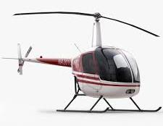


What’s Next for the ACS?
In development:
Instructor (Airplane)
Airline Transport Pilot & Aircraft Dispatcher (Airplane)
Aviation Maintenance Technician – General, Airframe, and Powerplant
Rotorcraft & Powered-Lift
Notes:
So what’s next?
The FAA and its industry partners on the ACS Working Group are still developing Airman Certification Standards for the Airline Transport Pilot (airplane) and the Instructor (airplane) certificates.
In 2016, we also started work on an ACS for the Aircraft Mechanic Certificate with Airframe and/or Powerplant ratings.
Once we complete this work, we will be in a position to use these foundational ACS documents as the template for expansion to other certificates and ratings.

Slide 28



ATP ACS
Challenges:
  Certification vs Type Rating
  ATP Certification Training Program
  Standards for certification (not training)
  Moving the Notes to Appendices
Status:
  FAA has developed the initial draft
  ACS WG Industry representatives will review
  Public comment opportunity
Notes:
There are several challenges with the development of the ATP/Type Rating ACS.
One challenge that is unique to this ACS is that the evaluation standards in the PTS have served two purposes – initial ATP certification and initial type rating qualification. When you add the knowledge elements to the evaluation standard, they don’t necessarily apply to a type rating evaluation. Unless the initial ATP certification is done concurrently with a type rating, the need for evaluating elements missed on the knowledge test for a type rating, for example, is not necessary because a knowledge test is not required. How we structure the tasks and draft the guidance for use will be critical.
Along those same lines, we now have required training for the multiengine ATP certificate, which is a prerequisite to taking the knowledge test. This will be the FAA’s first opportunity to capture the knowledge elements for the ATP CTP in particular in a standards document for those pilots. Unlike other certificates, there is a greater difference in what a pilot must know between single-engine and multiengine class ratings.
Another challenge is ensuring we stick to establishing the evaluation standards – not the training standards. There may be areas that could or should be trained, but are not areas that require evaluation. While the document can help with training program development, it is not necessarily all-inclusive.
Finally, the ATP PTS has a significant number of notes – more than other PTS documents. With the existing ACS documents, those notes have been captured in the appendices. We intend to do the same with this ACS, but the volume and nature of the notes is large and is taking quite a bit of time to make sure they are captured appropriately.

Slide 29


Instructor ACS
Challenges:
  Make it practical!
  Structure – “different breed of cat”
  Risk management – teach and do
Status:
  ACS WG completing initial draft
  FAA/Community team will review
  “Tabletop” prototype ahead
  Public comment opportunity
Notes:
The Instructor ACS, like the ATP ACS has unique challenges that are not found in the PAR/IRA/CAX ACS. First, the applicant is responsible for the contents in the PAR and CAX ACSs. Not only must the applicant be able to, know, consider and do; they must also be able to teach, know, consider and do. So, that makes the structure of the document much different.
Currently our community partners are completing the initial draft. Once the draft is complete, the FAA and our Community partners will review the draft.
We are planning a tabletop prototype, and the public will have a comment opportunity.

Slide 30

Instructor ACS – Sneak Preview
Notes:
Here is a quick look at the instructor ACS. At least what is completed to this point.

Slide 31

Instructor ACS
Section 1 – Fundamentals of Instructing
Section 2 – Ground Instructor
Section 3 – Flight Instructor – Airplane
  Areas of Operation:
  Fundamentals of Instructing
  Technical Subject Areas
  Preflight Preparation
  Preflight Lesson on a Maneuver to be Performed in Flight
  Preflight Procedures
  Airport & Seaplane Base Operations
  Takeoffs, Landings, & Go-Arounds
  Fundamentals of Flight
  Performance Maneuvers
  Ground Reference Maneuvers
  Slow Flight, Stalls, & Spins
  Basic Instrument Maneuvers
  Emergency Procedures
  Multiengine Operations (to be developed)
  Postflight Procedures
Notes:
Section 1 will be the Fundamentals of instructing.
Section 2 is for the Ground Instructor.
Section 3 is Flight Instructor-Airplane. As you can see, there are 15 AOOs, that is 4 more AOOs than is found in the PAR/IRA/CAX ACSs. Yes, there is a lot of information to cover. And making it a user friendly document is a challenge.

Slide 32
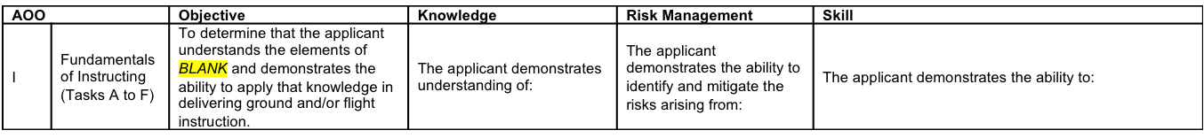
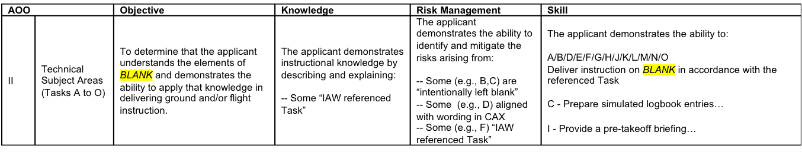
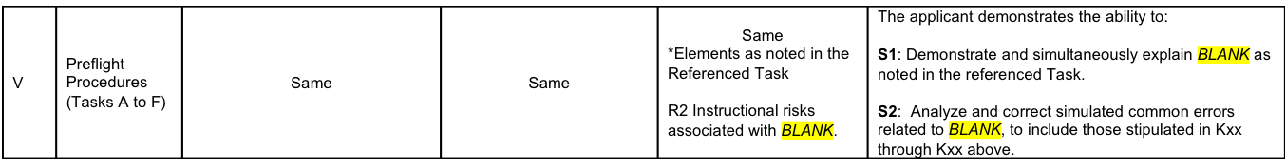
Instructor ACS
IV | Preflight Lesson (Task A) | Same | Same | Same | Deliver instruction on the selected maneuver, using teaching methods and aids that incorporate K1 through K3 above as appropriate.
Notes:
Here is an example of the AOOs and some of the Tasks/Elements from the Instructor ACS.

Slide 33
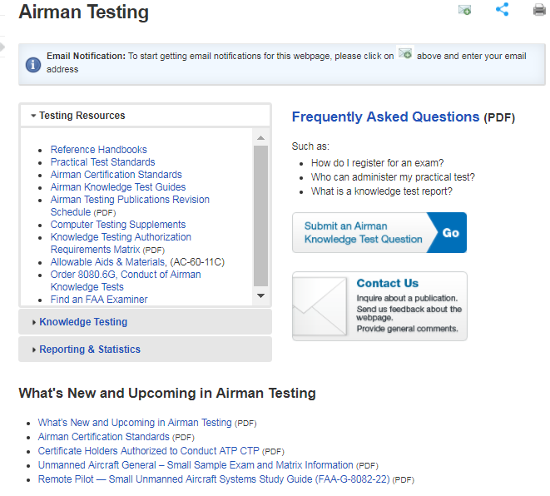
Airman Testing Webpage
Notes:
Let’s close with a look at some of the resources the ACS team has created to support use of these documents.
The FAA’s Airman Testing web page is the go-to source. It includes:
The ACS for Private Pilot Airplane (PAR) certificate, the Commercial Pilot Airplane (CAX) certificate, and Instrument-Airplane Rating (IRA)
ACS Frequently Asked Questions
An ACS Brochure
An ACS PowerPoint presentation with notes
Sample private, commercial, and instrument knowledge questions
A What’s New in Airman Testing document that includes a list of subjects deleted from airman knowledge tests.

Slide 34
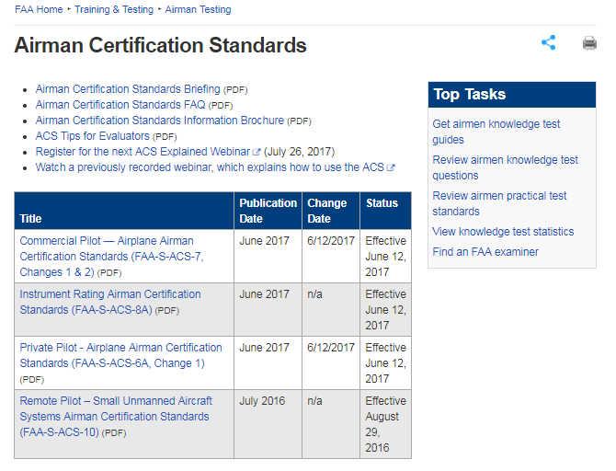
ACS Webpage
Notes:
The FAA established the ACS Focus Team as the one-stop-shop for answering any questions not addressed on the Airman Testing web page. Please contact the ACS Focus Team directly if you need help. There is no need, and no requirement, to go through anyone else! Just send an email to the ACS Focus Team address and you will get a response from us.
We hope you enjoy using the Airman Certification Standards, and we welcome your feedback and suggestions for continued improvement.

Slide 35

Thanks to Aviation Community Partners!
AOPA
Airlines for America (A4A)
ALPA
AnywhereEducation Inc.
AABI
Aviation Research Training & Services
ASA
ATEC
CAE
Cessna Pilot Centers
CAPA
ERAU
FAA
FedEx Express
Flight Safety International
GAMA
Gleim
Florida Institute of Technology
Florida State College
Jeppesen
King Schools
Liberty University
Mary Schu Aviation
NATA
NAFI
NBAA
Navy Technologies
Oxford Flying Club
Paul Alp, CFI
Polk State College
Redbird Simulations
RACCA
Robert Stewart, CFI
Savvy Aircraft Maintenance
Satcom Direct (Mariellen Couppee)
SAFE
Sportys Academy
UAA
UND
Notes:
Before we wrap up, it is very important to recognize and thank all those who have worked so hard on the ACS framework.
This slide lists the individuals and organizations in the aviation community who have contributed to the development of the ACS since this project started in 2011.
Please join us in thanking these dedicated members of the community for their great contributions.

Slide 36

Questions?
Airman Testing Webpage
  http://www.faa.gov/training_testing/testing/
  http://www.faa.gov/training_testing/testing/acs/
ACS Focus Team
  9-AVS-ACS-Focus-Team@FAA.gov
Notes:
This is our last slide, and as promised, these are the web site addresses for the Airman Testing Branch. And the email for the ACS Focus Team is also included.
Thank you for your time, and attention in this Webinar. Please feel free to contact us with any questions you may have.
I will leave the Webinar open a little longer for last minute questions.

